Slide 1
Notes:
PLEASE NOTE THE FOLLOWING USAGE REQUIREMENTS FOR THE FIRST® FORWARDSM presented by Qualcomm template.
Presentations using this deck must include the FIRST FORWARD cover slide (Slide 1) to ensure recognition of our presenting sponsor, Qualcomm.
Do not modify the template or overlap any of the built-in graphics.
This template uses the Roboto font family, which can be downloaded for free at fonts.google.com/specimen/Roboto

Slide 2
Judge Training

Slide 3
Introduce Yourself
Name
Job/Occupation
Fun fact (favorite dessert)
Affiliated Team or Organization (if you have one)
How did you learn about FIRST?

Slide 4
Timeline of Day
Morning Meeting
Formal Interviews
Initial Deliberations
Pit Interviews
Award Deliberations
Initial Deliberations
As a judging group we process, assign panels, and get ready for the morning interview.
Formal interviews are performed in judging panels. 10 minutes with each team.
We will reconvene as a group to rank each panel for each award and prepare for pit interviews.
In new panels you will interview teams at their pits and learn about their accomplishments in relation to specific awards.
Judging group will reconvene and review team accomplishments to determine award recipients.

Slide 5
Schedule (Example – 24 team event)
Time | Agenda
7:15 am | Judges arrive and check in
7:30 am | Report to Judge Deliberation room for Morning Meeting (room XXX)
8:00 am -10 am | Formal Interviews
10:15 am | Submit team nominations from Formal Interview
10:45 am | Opening Ceremony
11:15 am | Judges meet to create Award Panels
11:30 am | Pit Interviews and Portfolio Reviews
12:15 pm | Lunch and continuing Pit Interviews
2:15 pm | Award Deliberations
3:30 pm | Award Scripts reviewed by Judge Advisor
4:45 pm | Playoff Matches and Closing Ceremony
Notes:
*Example of a 24-team event with 4 judging panels and 20-minute formal interview blocks. Please feel free to change this to your event’s schedule.*

Slide 6
Judging in One Slide
Judges demonstrate Gracious Professionalism
We provide an inspiring and rewarding experience
We represent FIRST as ambassadors to the students
Judges validate the efforts of the students
We draw out and listen to their stories
We are the interactive interface with students
We value the students, their efforts, their teamwork
We recognize their accomplishments
Judges wrestle with the subjective
We accept the challenge of ranking the team efforts
We encourage all yet reward few

Slide 7
Your Goals
Cheerleader – compliment and encourage
Observer – listen and take notes
Detective – ask questions
Reporter – during final deliberation, communicate about your team(s)
Advocator – advocate for nominated teams, but be willing to compromise

Slide 8
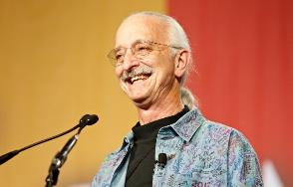
We express the FIRST® philosophies of Gracious Professionalism® and Coopertition® through our Core Values:
Discovery: We explore new skills and ideas.
Innovation: We use creativity and persistence to solve problems.
Impact: We apply what we learn to improve our world.
Inclusion: We respect each other and embrace our differences.
Teamwork: We are stronger when we work together.
Fun: We enjoy and celebrate what we do!
Gracious Professionalism ® is doing things that encourages high-quality work, emphasizes the value of others, and respects individual & community.
Coopertition® is based on the concept and a philosophy that teams can and should help and cooperate with each other even as they compete.

Slide 9
Bias and Differences
Understanding Differences
Identifying Bias
All our students are unique and have different strengths. We need to be aware and adjust our expectations of students.
We need to be aware of any conflicts of interests and previous bias we may carry into judging. We want to only evaluate teams on their performance this season alone and in the fairest way.

Slide 10
Conflict of Interest
All Judges are asked to disclose any potential Conflicts of Interest, and to complete the Conflict of Interest and Disclosure form.
During the Judges meeting, Judges must declare any potential conflicts to the rest of the Judging pool. Some scenarios of conflict of interests:
• A coach/mentor is volunteering as a Judge.
• A parent/relative of a team member is volunteering as a Judge.
• An alum (student or adult) of a team competing at the event is volunteering as a Judge.
• A sponsor of a team that is competing at the event is volunteering as a Judge.

Slide 11
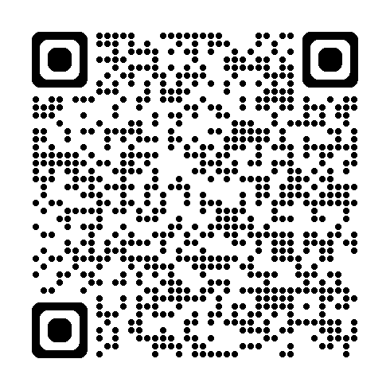
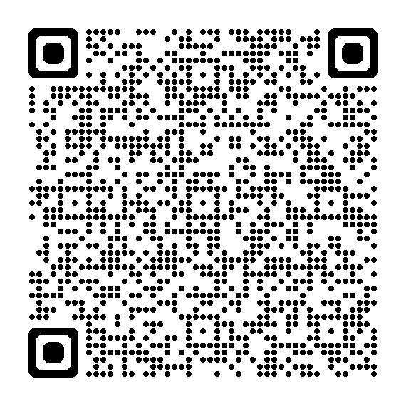
Conflict of Interest - Continued
A volunteer who does not disclose their conflict of interest can compromise the integrity of FIRST Tech Challenge events. In some cases, this could cause teams affiliated with the volunteer with a conflict of interest to be removed from consideration for awards.
Conflict of Interest Definition
Conflict of Interest Form

Slide 12
FORMAL INTERVIEWS – baseline questions
During the Formal Interview, each Judging Panel must ask every team they interview 2 baseline questions. One selected from the Team Attribute question bank, and one selected from the Machine, Creativity, and Innovation bank. The questions selected for this event are:
(add Team Attribute Question Here)
(add Machine, Creativity, and Innovation Question Here)

Slide 13
FORMAL INTERVIEWS
Greet team - smile - welcome them in
Ask for portfolio – teams are not required to have a portfolio for most awards
Ask if the team has a presentation – teams are not required to have a presentation
Patiently & eagerly listen to team’s ~5 minute presentation
Take good notes
After presentation, ask questions & take notes for remaining time to fill up to 10 minutes. Please note that all teams should receive the same amount of judging interview time and the first 5 minutes of the presentation is reserved for the team’s prepared presentation (Competition Manual rules A105 and A107).
Ask the questions provided to you by the Judge Advisor
Work with your panel partners to cover all award areas
All teams will receive the same amount of formal interview time (10 minutes)
After 10 minutes, team leaves. We will help with timing but need your help as well.

Slide 14
Formal Interview Timeline
Review portfolio and complete forms: feedback, summary
5-minute presentation
Q & A
Greet Team
5 min
5 min
10 min
Team enters
Team leaves
Open the door to ask next team in

Slide 15
AFTER EACH TEAM INTERVIEW
Discuss notes amongst the panel - decide if team is a potential nominee for shortlisted awards – you get to pick up to 2 teams for each:
Connect / Motivate / Innovate / Design / Control / Think
Review portfolio (Think Award)
Decide if portfolio merits being kept into contention - you get to pick up to 3 teams for Think
Consider if team might merit a Judges’ Choice Award & if so, why?
Fill out 1 Team Judging Feedback Form for team as a group
Notes:
This may vary depending on the event size.

Slide 16
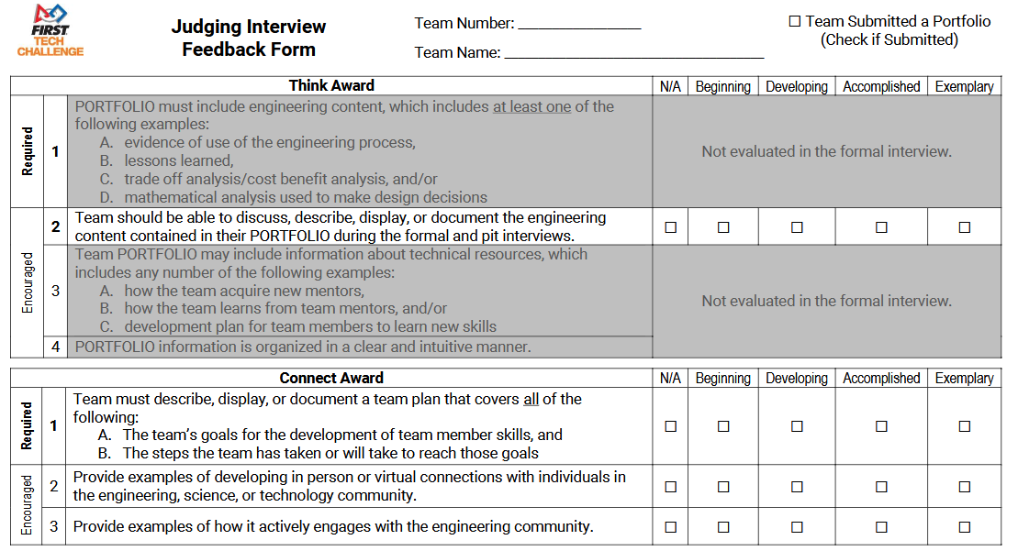
Judging Feedback Form
Items highlighted in gray are not generally a part of the formal interview process.
Judging Feedback covers only content shared during the formal interview process, and does not include content from the portfolio, pit interviews, or performance observed in matches.

Slide 17
Differentiating Awards
You may find the same teams listed in both the Motivate and Connect Award lists. The differences between these awards are subtle.
Connect Award: focuses on outreach to the science, technology, engineering, and math communities.
Example: Recruiting a mentor to help the team with computer programming might count for the Connect Award.
Motivate Award: focuses on outreach to individuals or organizations that are not science based.
Example: Creating a team in a new school might count for the Motivate Award.

Slide 18
Differentiating Awards
Similarly, there may be teams who are nominated for both the Design Award and the Innovate Award. The differences here are subtle as well.
Design Award: has specific mention of CAD or technical drawings, and it rewards industrial design, robot elegance, simplicity, and durability.
Innovate Award: rewards innovative thinking, creativity, and ingenuity.

Slide 19
AFTER ALL INTERVIEWS
Decide Your Panel’s shortlists: Discuss which teams your panel would recommend for each of following awards:
up to 2: Connect / Motivate / Innovate / Design / Control
up to 3: Think
Grab everything - all notes, feedback forms, all portfolios & all Control Summary Sheets back to Judges Room
DEADLINE FOR SHORTLISTS IS X:XX AM

Slide 20
Deliberations (Afternoon)
Pit Interviews
All Judging teams will describe and advocate for their 1st ranked team and agree on the best team.
Continue until you reach the top 6 teams
More to come!

Slide 21
Judging Question Bank

